Slide 1
Weather App
By Aman

Slide 2

Technologies Used
HTML
CSS
JAVASCRIPT

Slide 3
Step 1
At first we will create a HTML file to create our web page.
Then we will create structure of our web page including search box , search button, humidity and wind speed.
Then we will add .png images of search , humidity icon and wind speed.
And we will create a css file and add it to HTML file as an external file.

Slide 4
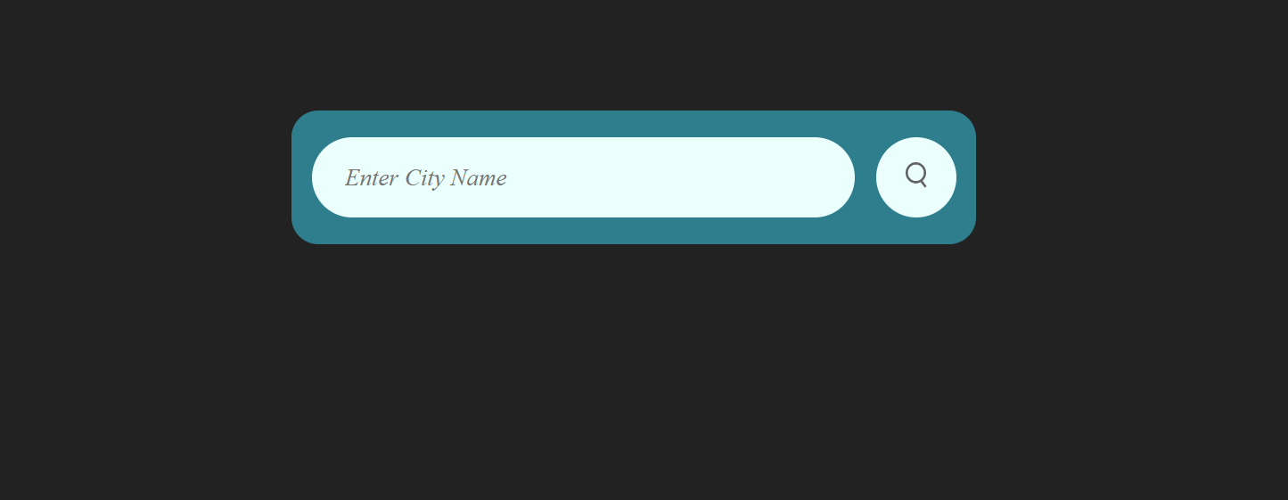
Step 2
Now its time to add properties to our css file.
We have used background color, padding , border radius , align items , font size , display and font size like properties .
After adding these properties our page will look like this

Slide 5
Step 3
Now at 3rd step we have to API Key.
To get API Key visit the website of Open Weather Map and register yourself and get your Key.
After few hours Key will start working.
And to use API key we need API URL like this: https://api.openweathermap.org/data/2.5/weather?units=metric&q=
And we have edit URL to get the data units in Celsius.

Slide 6
Step 4
At this point we will create our Javascript.
At first we need to declare const variables of API Key, API URL and our search box, search button and weather icon.
Then we will async function getting argument as city name.
In this function we will fetch API URL and API Key.
And we need to get data in json format so, we use response.json().
We have to add addEventListener to search button so, it can work.

Slide 7
Step 5
Then we will open our web page in web browser and open console to side of it.
And in console we can see what our API call is retrieving .
Then we have to add data according to Console’s data.
Like we find wind related data in console and update data in web page to that field of wind.

Slide 8
Step 6
At last step we have to do some modifications so that our application looks better.
First of all, we need to update weather image according to our data.
We have five options like – clear , clouds , drizzle , mist and rain.
So we have to add them to our code in nested if else statements.
We have added another modification of getting output as “Invalid City Name” whenever we enter wrong city name. Api call will show message 404 in that case.
And another modification is we can hide weather details if we haven’t enter city name.

Slide 9
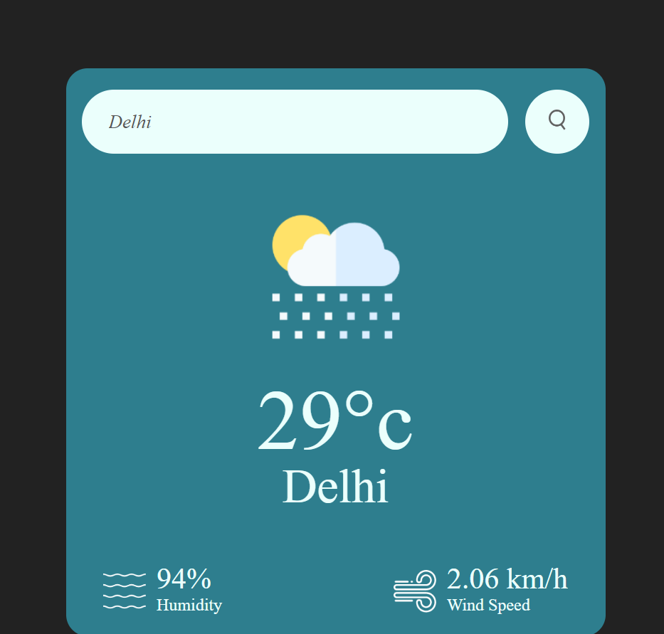
Results

Slide 10
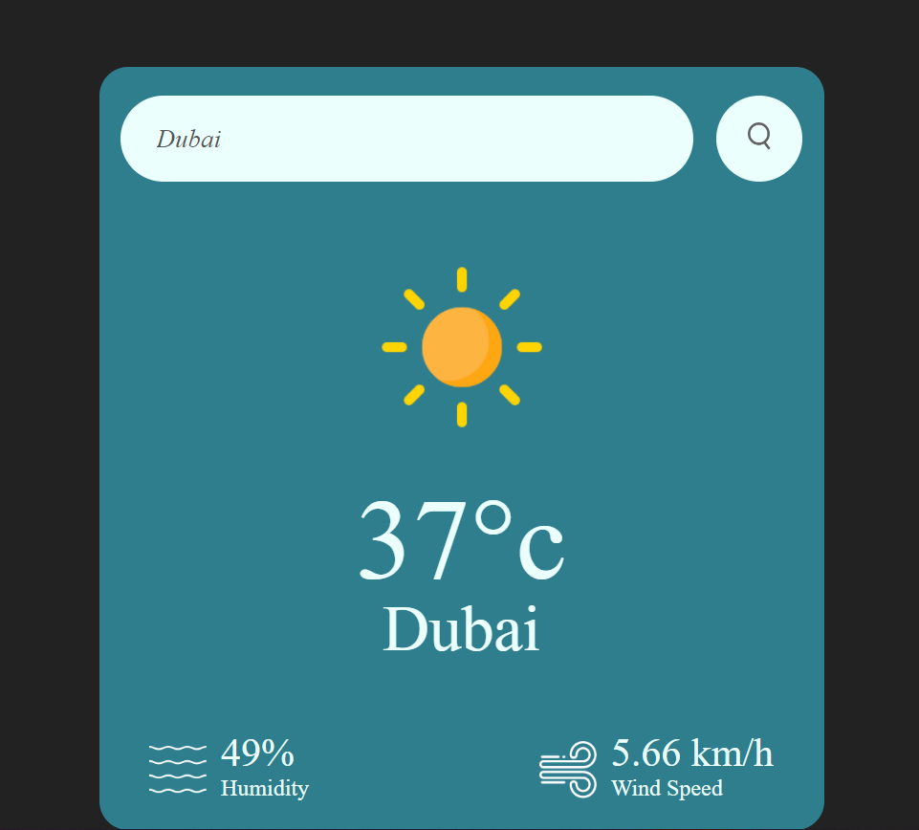

Slide 11
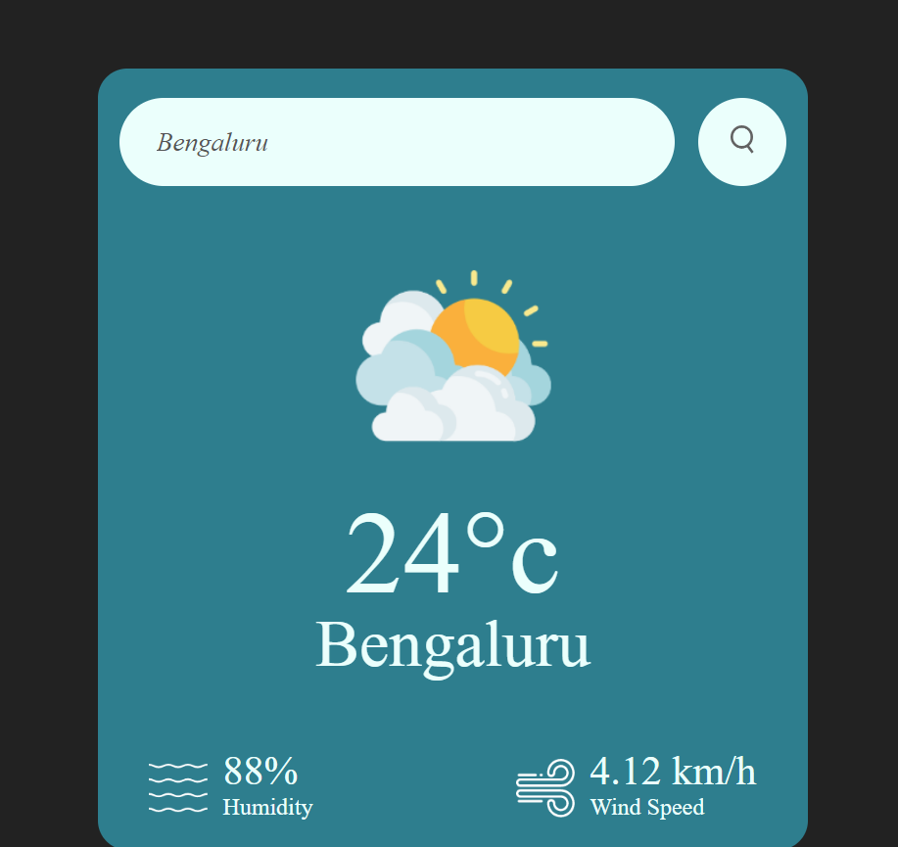

Slide 12
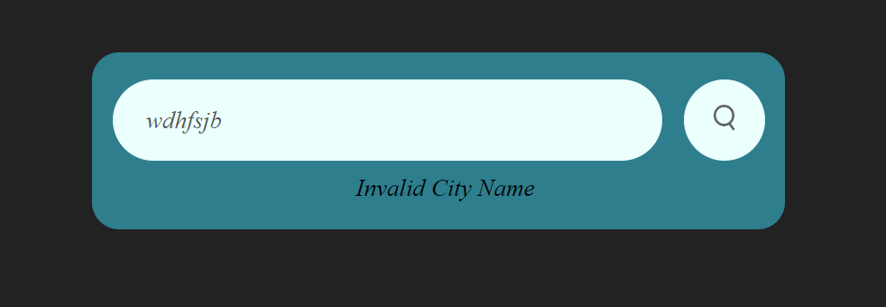
THANK YOU

